Slide 1
Function Blocks of OWCI Software
General Setting
Hardware control, include pilot width and device address.
Test Mode
Enter Test Mode, supporting different DUTs.
Registers Read/Write
Single or burst registers read or write.
OTP Window
OTP operation, bit by bit or byte by byte, load data from a .txt file and save data to a .txt file.
Script Window
Load script from a .txt file and execute, edit a script and execute or save to .txt file.
Fuse
Support eFuse.
Operation log
Display all the operations include commands and return data

Slide 2
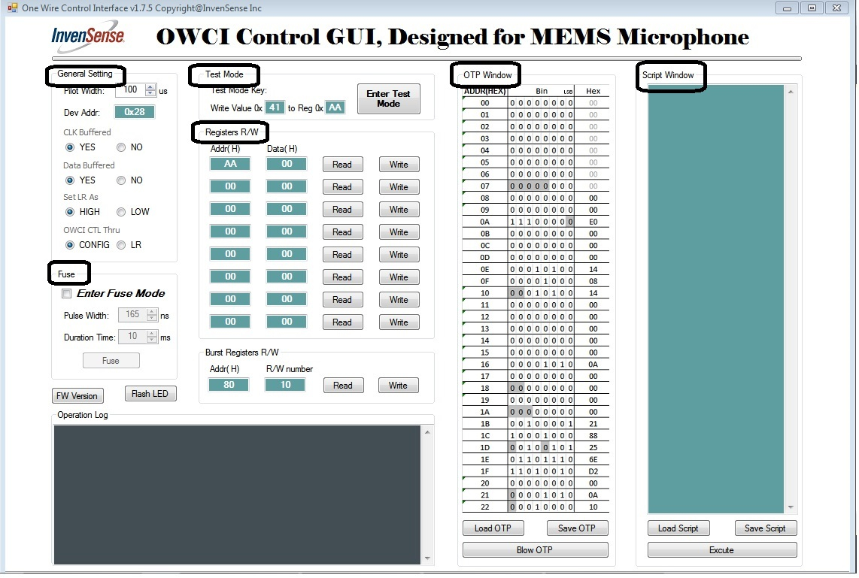
Over View of OWCI Software

Slide 3
Blocks Review 1
General Setting,
Test Mode,
Registers Read/Write,
Fuse.
These operations are almost the same as last version software.

Slide 4
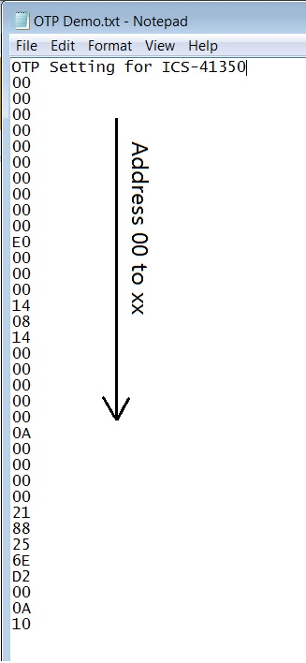
Blocks Review 2
Functions of OTP Window
Edit the window directly, supporting edit bit by bit or byte by byte, and blow OTP;
Save window data to a .txt file as right format;
Load data form a .txt file as right format, and blow OTP;
After load, also can edit the updated window, and then save to a file or blow OTP;
Command line supporting, ext. writeotp.exe OTP Demo.txt blowotp.exe OTP Demo.txt (Note: xxxxotp.exe and OTP Demo.txt must be in same directory).
OTP setting name

Slide 5
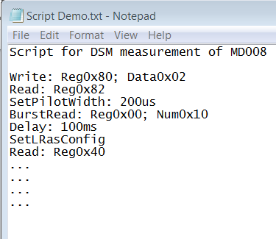
Blocks Review 3
Functions of Script Window
Edit a new script, and execute;
Edit a new script, and save to a .txt file as right format;
Load script form a .txt file as right format, and execute;
After load script, also can edit in the updated window, and then choose to save to a new file or execute.
Command line supporting, ext. execute.exe Script Demo.txt (Note: xxxxotp.exe and OTP Demo.txt must be in same directory).
Script name
Command
!!! Each command in single line

Slide 6
Supporting Commands
Write: Addr 0x80; Data 0x10
Read: Addr 0x80
BurstWrite: Addr 0x80; Num 0x10; Data 0x00
BurstRead: Addr 0x80; Num 0x10
SetPilot: 200us
SetDelay: 100ms
Fuse: 160ns; 10ms
WriteOTP:
ReadOTP:
BlowOTP:
SetLRasOwci:
SetConfigasOwci:

